Slide 1
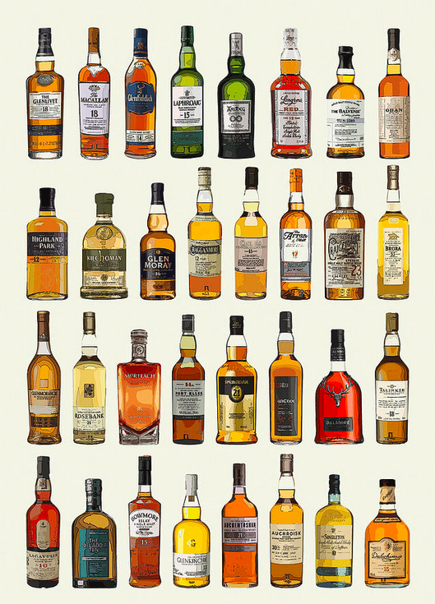
Whiskey Advocate
Web-Scraping Project
Jay Chudasama

Slide 2
TABLE OF CONTENTS
Project Goals
What is Whiskey Advocate?
Data Dictionary
Data Analysis
Recommendations
Future Work

Slide 3
PROJECT GOALS
Is there a strong relationship between price and rating?
Select top rated whiskies that costs less $ 150

Slide 4
WHAT IS WHISKEY ADVOCATE?
America's leading whisky publication for whisky enthusiasts
There are over 5,000+ whiskey reviews
Subscription model for services/events

Slide 5
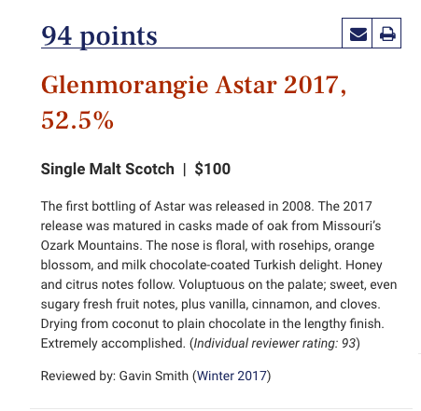
DATA DICTIONARY
Category – Whiskey category
Brand – Whiskey brand
Title – Whiskey title
Alcohol Percentage- Alcohol Content
Price: Price of the whiskey bottle (USD)
Reviewer: Reviewed by
Review: Rating (out of 100):
95-100 points—Classic: a great whisky
90-94 points— Outstanding: a whisky of superior character and style
85-89 points—Very good: a whisky with special qualities
80-84 points—Good: a solid, well-made whisky
75-79—Mediocre: a drinkable whisky that may have minor flaws
50-74—Not recommended

Slide 6
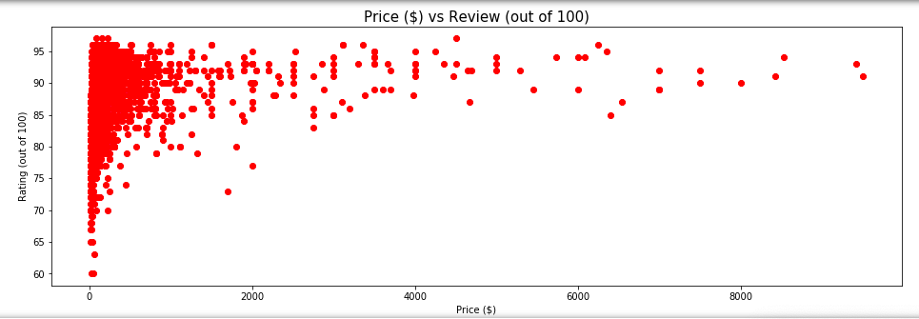
DATA ANALYSIS
Price vs. Review
Does price yield a better overall rating? As expected, as you increase price, the overall rating increases.

Slide 7
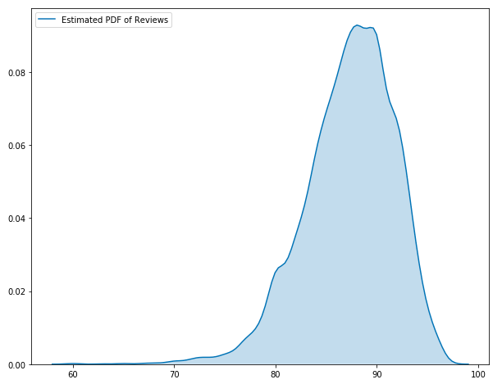
DATA ANALYSIS
Review Distribution
We can see the the reviews are distributed around 85-95 out of 100. In general, if you were to pick a whiskey bottle randomly you would most likely pick a bottle that reviewed well.

Slide 8
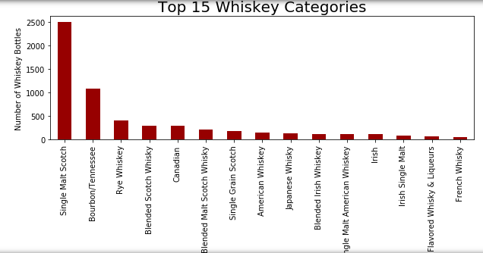
DATA ANALYSIS
Top 15 Whiskey Categories
As expected, there's a large number of single malts (Scotch) in excess of 2,000 bottles, followed by Bourbon.

Slide 9
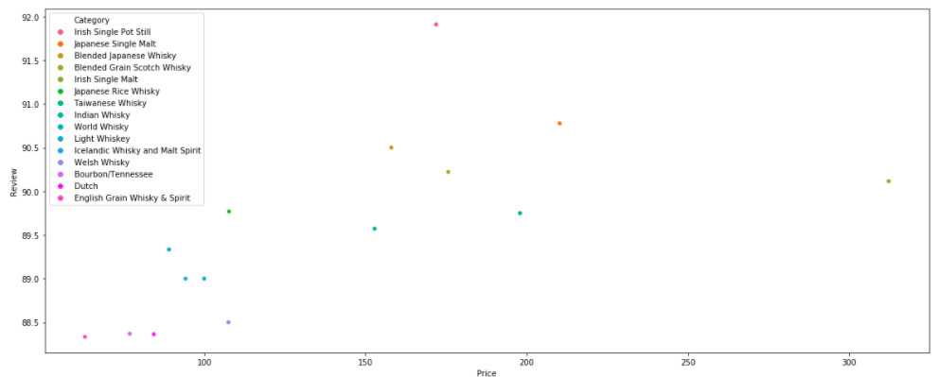
DATA ANALYSIS
Average - Category Review vs Price – Top 15
The 'Irish Single Pot Still' category on average contained the highest reviews at a price of < $200 and scoring 92 out of 100.
Japanese whiskies are ranked second which is no surprise due to its high popularity.
However, I would have expected Single Malt Scotch to be in the top 15 considering there are over 2,000 different whiskies in this category.

Slide 10
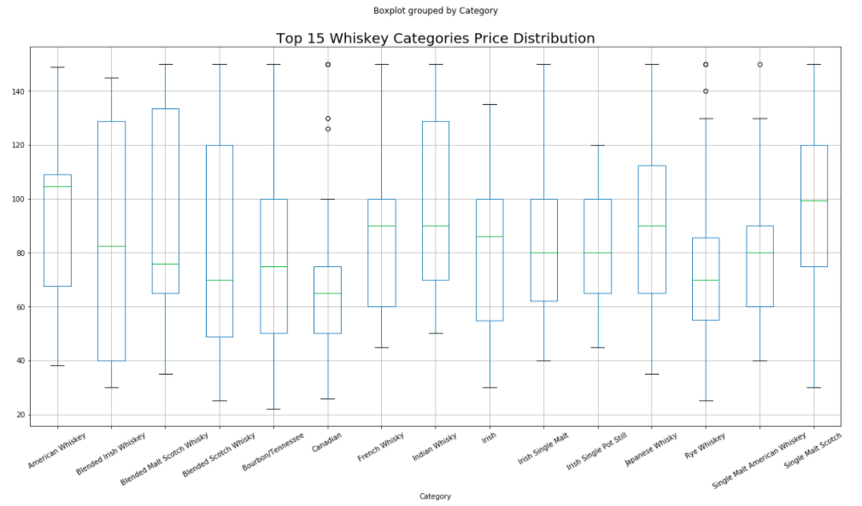
DATA ANALYSIS
Price (<$150) Box Plot – Top 15
Single Malt Scotch and American Whiskies cost on average of ~$100
Canadian whiskies were priced at $65
Blended Malt Scotch Whiskies have the greatest dispersion.

Slide 11
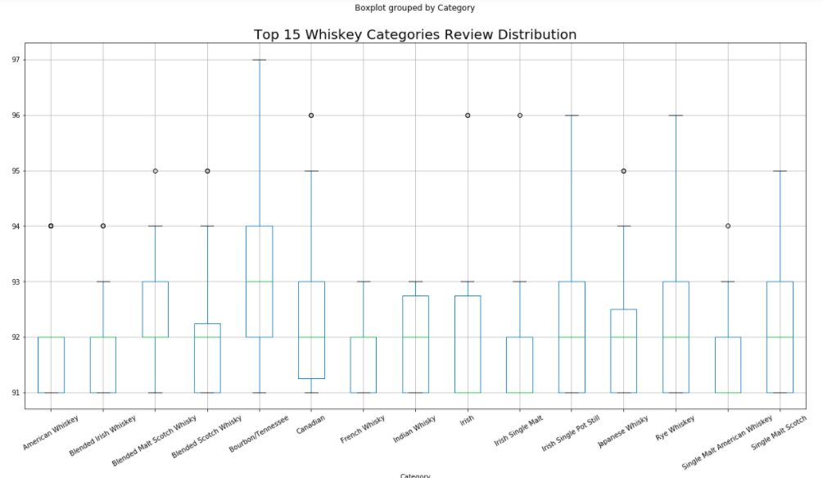
DATA ANALYSIS
Review (<$150) Box Plot – Top 15
Bourbon/Tennessee on average yielded a greater review of 93/100 vs Irish/American Single Malts reviewed less favorably.
Before we highlight a final selection of top whiskies, lets now calculate the rating points per $1 spent.

Slide 12
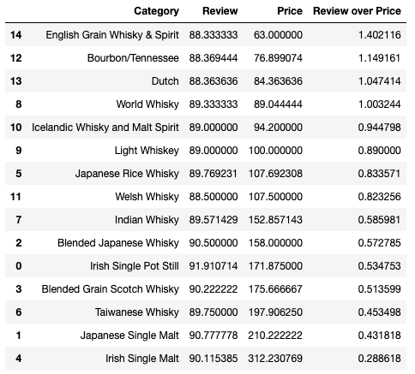
DATA ANALYSIS
Review Points/$1 – Top 15
For every $1 spent, English Grain Whiskey yielded a 1.4 review points but there are not many bottles in this category
Bourbon yielded 1.15 review points for every $1 spent
For every $1 spent, Irish single malts yielded 0.29 review points
While Japanese whiskies are popular, you would need to spend more for a good bottle – 0.43 points per dollar spent

Slide 13
RECOMMENDATIONS
Price does yield a highly rated whiskey.
The top whiskies of choice purely based on price/review were two Bourbons:
Parker's Heritage Collection, 'Golden Anniversary - $150 – Score 97/100
Four Roses Limited Edition Small Batch (2013 Release) - $85 – Score 97/100

Slide 14
FUTURE WORK
To expand this data analysis, I would also extract key terms from the actual review vs only the score. This would help drive further insight and develop a more meaningful analysis.
The overall conclusion, assumes all whiskies are the same. However, there are many differences between bottles within a category and across categories. For example, Bourbons are sweet and some Scotch whiskies are smoky in flavor. This analysis needs to be refined to capture these differences, and to identify a selection unique to the reader.
As a closing comment, the prices in this data set needs to be reviewed and rerun. For example, the Parker's Heritage Collection, 'Golden Anniversary' whiskey bottle costs $4,000 and not $150. Spot checking other whiskies also confirms the prices are stale.

